Slide 1
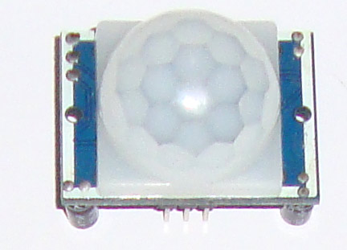
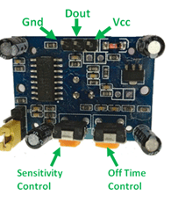
PIR Motion Sensor

Slide 2
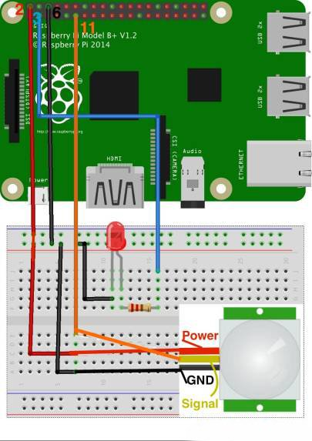
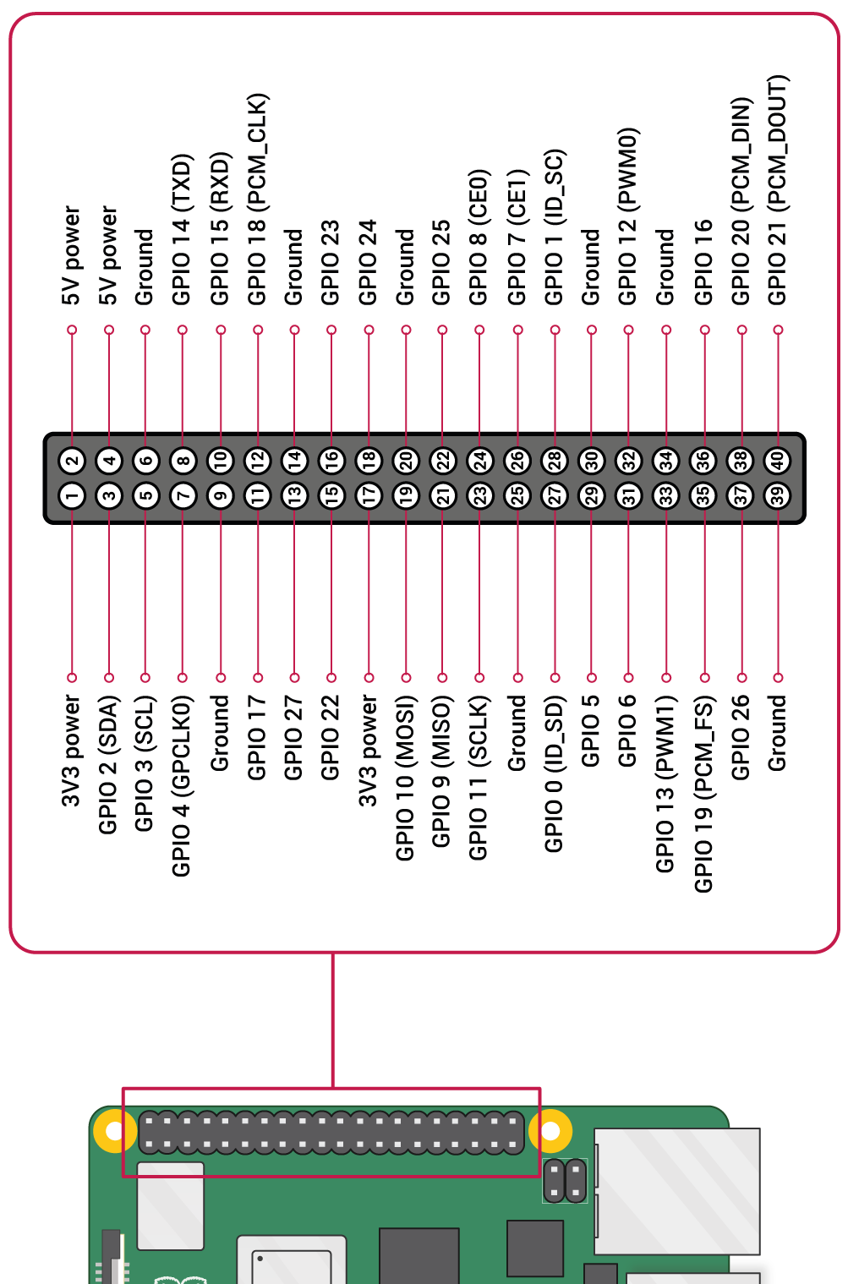
Motion sensor + LED

Slide 3


Example idea:
Smart night light
When there is motion → turn on light
When there is no motion → turn off light
Hints:
pir = MotionSensor(2)
pir.wait_for_motion()
pir.wait_for_no_motion()
https://gpiozero.readthedocs.io/en/stable/api_input.html#motionsensor-d-sun-pir

Slide 4
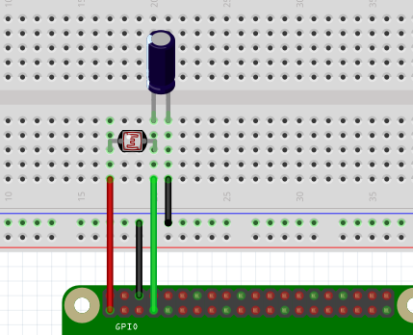
Motion sensor + LED + LDR

Slide 5


Example idea:
Smart’ER’ night light
Night light turns on/off based on both:
The environment’s brightness
The detected motion
Hints:
pir = MotionSensor(2)
ldr = LightSensor(4)
https://gpiozero.readthedocs.io/en/stable/api_input.html#motionsensor-d-sun-pir
https://gpiozero.readthedocs.io/en/stable/api_input.html#lightsensor-ldr

